Slide 1
Program Evaluation
Randomization and other methods

Slide 2
Outline
Who am I
Student introductions
Syllabus
History of randomization
Counterfactual – words and graphs
Potential Outcomes Framework – Rubin Causal Model
Benefits and limitation of RCTs
  The development economic debate
Difference-in-Difference model
Regression Discontinuity Design

Slide 3
Class website
https://ibs.colorado.edu/barham/courses/econ8784/
Password protected since I have journal articles there
Username: econ8784
Pass: econ8784

Slide 4
Syllabus Assignments
Tentative: the timing of topics may change
Choose a topic day: think about it, but we will see how the first few weeks go with timing
Assignments
  Short write-up in the syllabus
  Presenting a paper: choose your partner and email me your first and second choice paper by Thursday.

Slide 5
History of Randomization
1747 James Lind “father of clinic trials”
  Introduced concept of control and experimental group.
  Demonstrated the benefits of citrus fruits in preventing scurvy using a scientific experiment.
  Method of randomly assigning subjects came later.
  Read: Duncan P. Thomas. 1997. “Sailors, Scurvy and Science,” Journal of the Royal Society of Medicine, 90:50-54.

Slide 6
History of Randomization
1920s: Ronald A. Fisher
  Introduced randomization in scientific trials with agricultural experiments
  Book “The Design of Experiments”
  Focus on small scale (plants and animals)
1960s: Large Scale Social Experiments
  US and Europe (e.g. Perry Preschool project 1962)
  Evaluate programs: electricity pricing schemes, employment programs, welfare programs, housing allowances.
1992 Heckman:
  Article “Randomization and Social Policy Experiments” in book Evaluation Welfare and Training Programs or NBER working paper 107

Slide 7
History of Randomization
Development Economics
  Concern about reliable identification of program effects – Internal Validity.
  Deal with “Fads” and “Pet” projects in development
  Mid 1990s: Experimental work aimed at answering questions about the education production function.
    Better access to inputs matter for school attendance and test score?
    Change one factor at a time:
      Textbooks, flipcharts, student-teacher ratios, health (deworming – Busia Kenya)
      Textbooks and reducing student teacher ratios not effective at improving test scores.
Notes:
Learn the countries that each of these interventions were done in.

Slide 8
History of Randomization
    Surprise: deworming was effective at reducing absenteeism, and 29 times more effective as hiring an extra teacher.
1990s -Conditional Cash Transfers (CCTs)
  Randomization of large social experiments
  First large scale randomization of anti-poverty program, Progresa, in Mexico
  Mexican Economist main architect – Santiago Levy
  Outside evaluations – profs from USA
  Base-line and multiple follow-up surveys
  Find important short-term effects
  Program lasts government change, now Oportunidades

Slide 9
Why is Randomization Popular?
The Evaluation Problem
Impact evaluation assess changes in an outcome (well-being) that can be attributed to a particular policy /intervention/program.
Assesses causal effect of a program on relevant outcomes
  Key ingredient: counterfactual
    Asks would have happened to those receiving the intervention if they had not received the program
  Without the counterfactual, it is not an impact evaluation

Slide 10
The Evaluation Problem
Answers the questions
  How would individuals who participated in the program have fared in the absence of the program?
  How would those who were not exposed to the program have fared in the presence of the program?

Slide 11
The Evaluation Problem
What do we mean by “impact”?
  Impact = the difference in the outcome with and without the program on the same unit (clone) (individual, community, health clinic)
  Never observe person (unit) in two different states of nature at the same time.
Missing data problem
  Outcome for the person who received the intervention is observed
  Outcome for this same person in the absence of the program is not

Slide 12
The Evaluation Problem
In words
Need a GOOD or VALID counter-factual
  A way of determining the missing data
  What would have happened had the person not received the program
What is a way to do this?

Slide 13
Potential Outcomes Framework
Answering a question with causal inference:
  What is the effect of vaccinating children on cognitive functioning?
  What is the effect of health on income?
  What is the effect of tracking students on test scores?
Need a counterfactual
  How would individuals who participated in the program have done in the absence of the program?
  How would those not exposed to the program have done in the presence of the program?
Missing data problem – fundamental problem with causal inference.

Slide 14
Potential Outcomes Framework
Before and After Analysis
  Look at some person over time.
  Program effect:
  Outcome after program – outcome before program
What are the problems with this?
Does take into account any changes that happened over time

Slide 15
Potential Outcomes Framework
Treatment versus Comparison: compare group exposed to group not exposed?
What is the problem with this?
Are they the same?
  Selection bias
    Participation voluntary: Type of people who take-up or were eligible for the program may be very different from those who did not
      Wouldn’t expect the program to have the same effect
    Programs are Targeted: Program areas will differ in observable and unobservable ways precisely because the program intended this
      i.e. Job training program, want to see effect on employment of unemployed. Need to find a group with comparable education and past incomes.

Slide 16
Potential Outcomes Framework
Solution
Need to find credible control group
RANDOMIZATION often called the gold standard to determine allocation (i.e. like a lottery)
  See Deaton for critiques
If the group is being randomized is large enough, randomization process is highly likely to produce two groups that are statistically similar on average
    Statistically equivalent averages for all characteristics between treatment and comparison group
    Helps to make sure unobserved characteristics are similar as well as observed
    Can use baseline data to test that at least the observed characteristics are similar
Notes:
Can test that the two groups are similar on observables using the baseline data

Slide 17
The Evaluation Problem
Outcome (Y)
Outcome (Y)
Before the
Intervention

Slide 18
The Evaluation Problem
Outcome (Y)
Value of the outcome rises from Y₀ to Y₁
Before-After Analysis would show the impact of the program to be
Y₁- Y₀
Before the
Intervention
After the
Intervention
Intervention

Slide 19
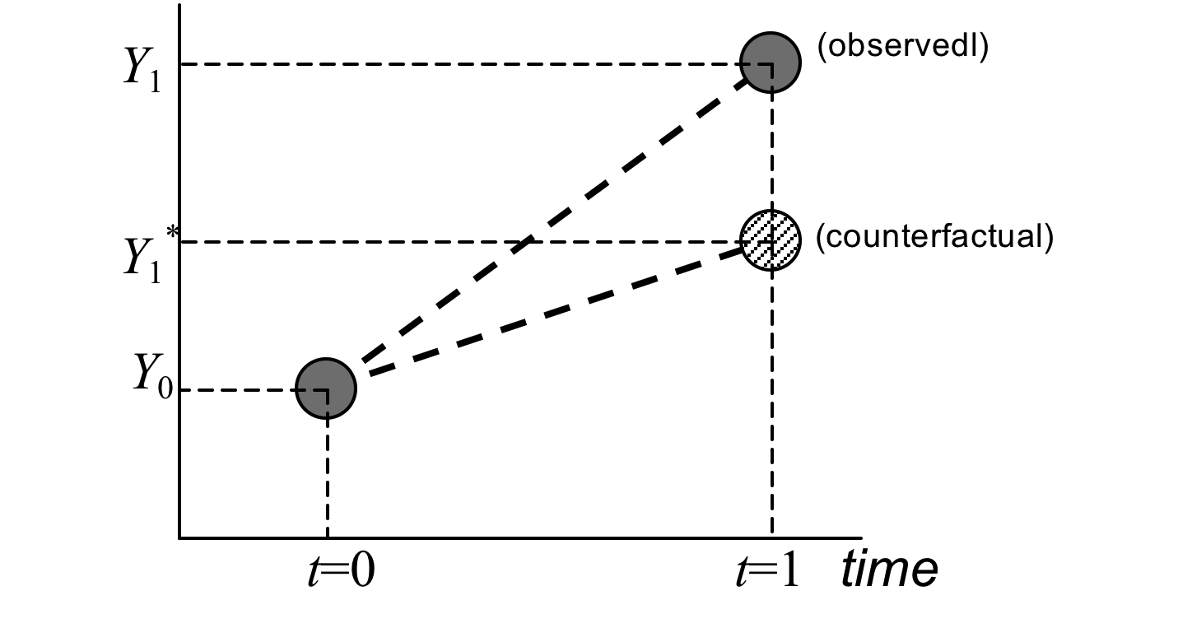
The Evaluation Problem
Add the counterfactual
Missing Data Problem
Before the
Intervention
After the
Intervention
Intervention
Notes:
Here is the missing data problem

Slide 20
The Evaluation Problem
True impact

Slide 21
Treatment and Comparison
3 Similarities Needed (Gertler et al 2008)
T and C must be similar in absence of the program.
  Mean of Y for treatment and control must be the same, had the treated never been treated.
  Not a testable assumption but can test if baseline characteristics need to look the same
    See if Y is the same for treatment and control prior to the program. Also see if other pre-program characteristics same between T and C. T-test

Slide 22
Treatment and Comparison
3 Similarities Needed (Gertler et al 2008)
Treatment and comparison must react to the program in the same way
  E.g. if a job training program, the incomes of T should be able to benefit the same way as the incomes of C
  This may not be the case if your comparison group is not an RCT and one area richer than other,
Contamination: T and C cannot be differently exposed to other interventions or programs

Slide 23
Potential Outcomes Framework
Y_{i} is the outcome for individual i
  indicates if person i has a disease, cognitive functioning measure
There are i = 1 to n individuals
  Individuals 1 to m participate and m+1 to n do not participate
The average (mean) Y over all n individuals
Expectation of Y:
Expectation of Y conditional on participating

Slide 24
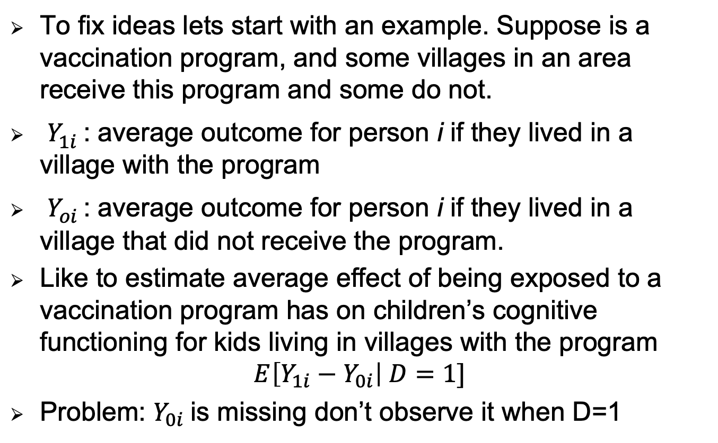
Potential Outcomes Framework
To fix ideas lets start with an example. Suppose is a vaccination program, and some villages in an area receive this program and some do not.
$Y_{1i}^{}$: average outcome for person i if they lived in a village with the program
$Y_{oi}^{}$: average outcome for person i if they lived in a village that did not receive the program.
Like to estimate average effect of being exposed to a vaccination program has on children’s cognitive functioning for kids living in villages with the program
$$E\left[Y_{1i}−Y_{0i}\right| D=1]$$
Problem: $Y_{0i}$is missing don’t observe it when D=1

Slide 25
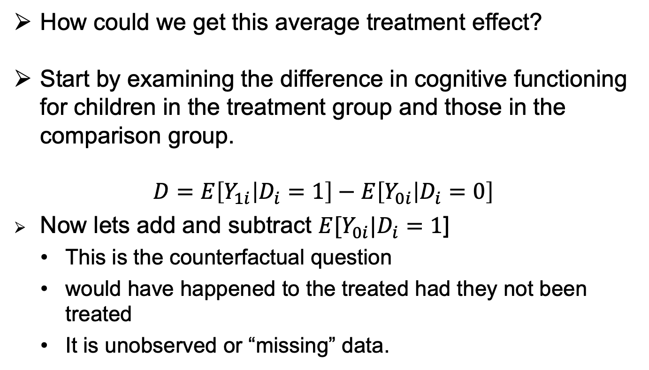
Potential Outcomes Framework
How could we get this average treatment effect?
Start by examining the difference in cognitive functioning for children in the treatment group and those in the comparison group.
$$D=E\left[Y_{1i} | D_{i}=1\right]−E\left[Y_{0i} | D_{i}=0\right]$$
Now lets add and subtract $E[Y_{0i}|D_{i}=1$]
  This is the counterfactual question
  would have happened to the treated had they not been treated
  It is unobserved or “missing” data.

Slide 26
Potential Outcomes Framework
$$D=E\left[Y_{1i} | D_{i}=1\right]−E\left[Y_{0i} | D_{i}=1\right]+E\left[Y_{0i} | D_{i}=1\right]−E\left[Y_{0i} | D_{i}=0\right]$$
First two terms are conditional on D=1, so can bring together
$$D=E\left[Y_{1i}−Y_{0i} | D_{i}=1\right]+E\left[Y_{0i} | D_{i}=1\right]−E\left[Y_{0i} | D_{i}=0\right]$$
TOT
Selection Bias
First term: is effect of treatment on the treated (TOT)
Difference between if get program or don’t but are treated
Second Term: Selection Bias
Expected difference in the outcomes without the program between the treatment and comparison groups

Slide 27
Potential Outcomes Framework
$$D=E\left[Y_{1i}−Y_{0i} | D_{i}=1\right]+E\left[Y_{0i} | D_{i}=1\right]−E\left[Y_{0i} | D_{i}=0\right]$$
If we just compare areas with and without the program, we get the treatment effect (green), but also have selection bias term (part in red) so we don’t know effect of the program.
Is the bias term positive or negative?
  Could be either
  Negative bias: If government put program in a place that is typically worse off
  Positive bias: if program put in a places that is better off
We need the selection term to be zero
What can we do so that this term is zero?
  RANDOMIZE ELIGIBILITY FOR PROGRAM

Slide 28
Potential Outcomes Framework
Randomization solves to selection bias issue because:
If we randomize and sample sizes are large enough then outcomes between D=1 and D=0 will be the same in expectation or on average
Observables and unobservable characteristics the same
We can check that observables look the same, but what is key is that we can expect that the unobservables are also the same
This is the unconfoundedness assumption (or strong ignorability) of randomization
  Treatment assignment is independent of the outcomes in either hypothetical scenario.
$$E\left[Y_{0i} | D_{i}=1\right]=E\left[Y_{0i} | D_{i}=0\right]$$

Slide 29
Potential Outcomes Framework
$$D=E\left[Y_{1i} | D_{i}=1\right]−E\left[Y_{0i} | D_{i}=0\right]$$
With ignorability
Then if we also have SUTVA
  Stable Unit Treatment Value Assumption
  Potential outcomes of an individual are unrelated to the treatment status of any other individual
  Treatment status of anyone unit does not affect the potential outcomes of any other unit (i.e. no spill overs, no externalities, no general equilibrium effects
$$E\left[Y_{1i}−Y_{0i} | D_{i}=1\right]=E[Y_{1i}−Y_{0i}]$$
Average treatment effect on the treated (TOT)
  if full compliance and everyone takes up.

Slide 30
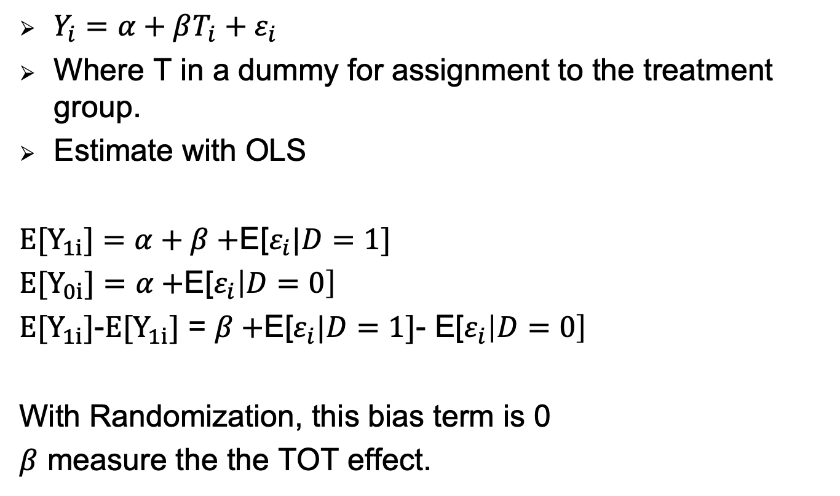
Regression Counterpart
Full Compliance
$Y_{i}=α+βT_{i}+ε_{i}$
Where T in a dummy for assignment to the treatment group.
Estimate with OLS
E[$Y_{1i}]=α+β+$E[$ε_{i}|D=1]$
E[$Y_{0i}]=α+$E[$ε_{i}\left|D=0\right]$
E[$Y_{1i}]$-E[$Y_{1i}]$ = $β+$E[$ε_{i}|D=1]$- E[$ε_{i}\left|D=0\right]$
With Randomization, this bias term is 0
$β$ measure the the TOT effect.

Slide 31
Regression Counterpart
Partial or Imperfect Compliance
Not all individuals who are eligible take up a program.
  So a person was assigned to treatment, but they didn’t get the treatment
  Maybe some people don’t want to vaccinate their child.
Or maybe some controls receive the program
  A person assigned to control, but they got the program
  Maybe some people in the control went and got their child vaccinated somewhere else, not through the program.
What should you do?

Slide 32
Regression Counterpart
Partial or Imperfect Compliance
What should you do?
Always use their eligibility status so the selection bias term will be zero!
Analysis need to focus on initial treatment assignment (eligibility), not what someone actually did (actual treatment status)
This is call “Intent-to-Treat” or ITT effect
Estimate is then ”internally valid”

Slide 33
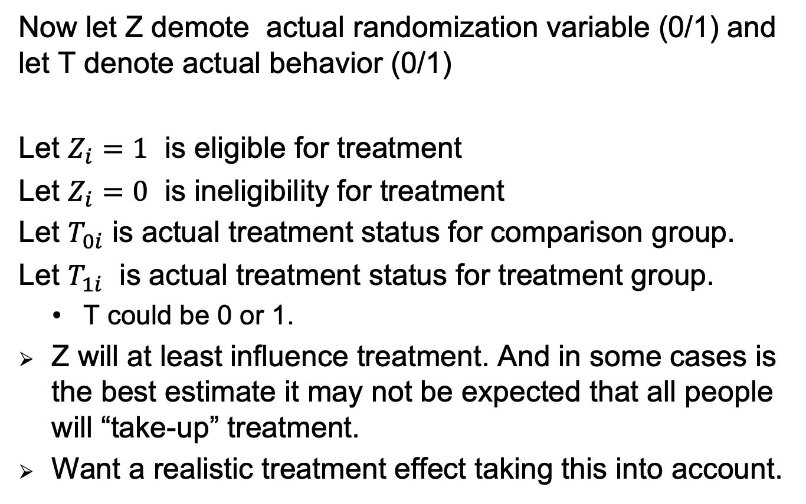
Regression Counterpart
Partial or Imperfect Compliance
Now let Z demote actual randomization variable (0/1) and let T denote actual behavior (0/1)
Let $Z_{i}=1$ is eligible for treatment
Let $Z_{i}=0$ is ineligibility for treatment
Let $T_{0i}$ is actual treatment status for comparison group.
Let $T_{1i}$ is actual treatment status for treatment group.
  T could be 0 or 1.
Z will at least influence treatment. And in some cases is the best estimate it may not be expected that all people will “take-up” treatment.
Want a realistic treatment effect taking this into account.

Slide 34
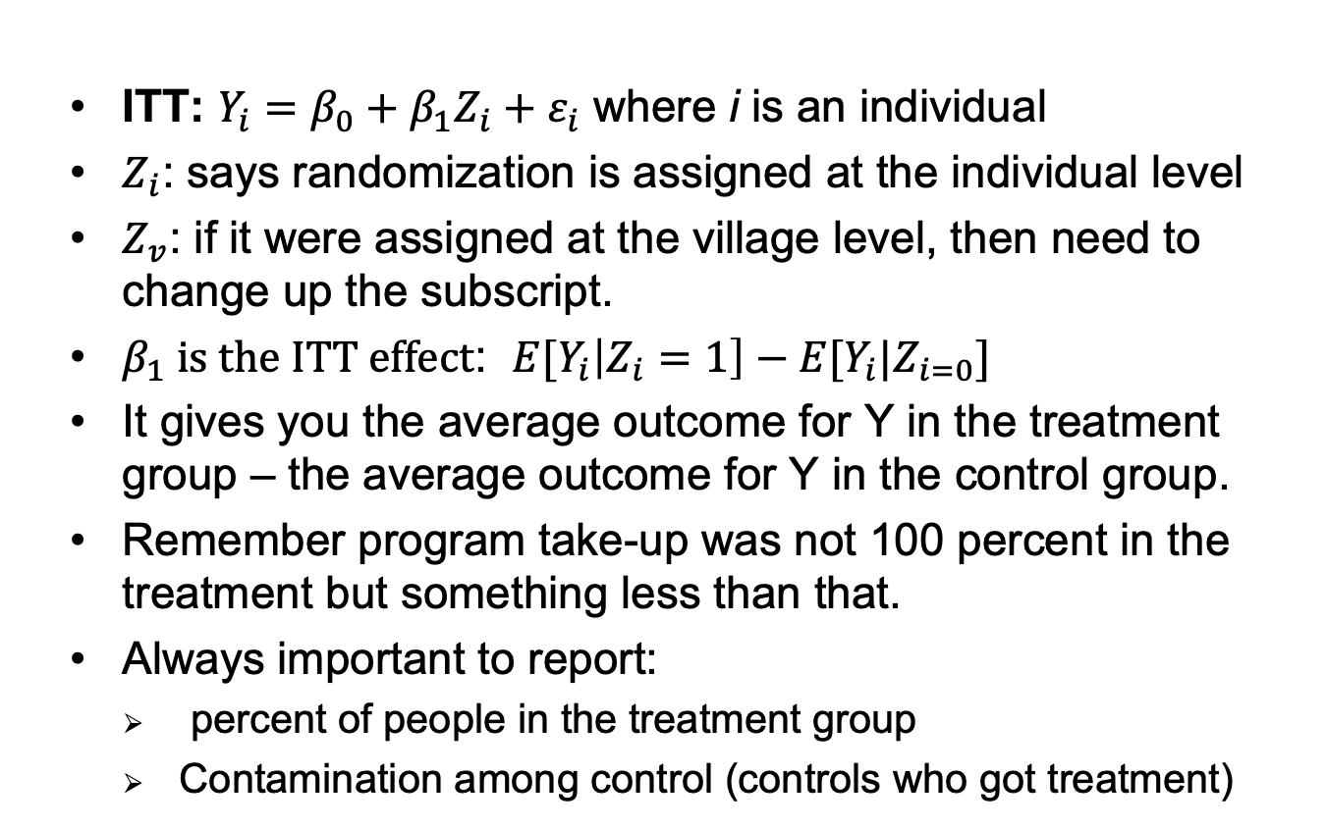
Regression Counterpart
Partial or Imperfect Compliance
  ITT: $Y_{i}=β_{0}+β_{1}Z_{i}+ε_{i}$ where i is an individual
  $Z_{i}$: says randomization is assigned at the individual level
  $Z_{v}$: if it were assigned at the village level, then need to change up the subscript.
  $β_{1} is the ITT effect$: $E{[Y}_{i}\left|Z_{i}=1\right]−E[Y_{i}|Z_{i=0}]$
  It gives you the average outcome for Y in the treatment group – the average outcome for Y in the control group.
  Remember program take-up was not 100 percent in the treatment but something less than that.
  Always important to report:
    percent of people in the treatment group
    Contamination among control (controls who got treatment)

Slide 35
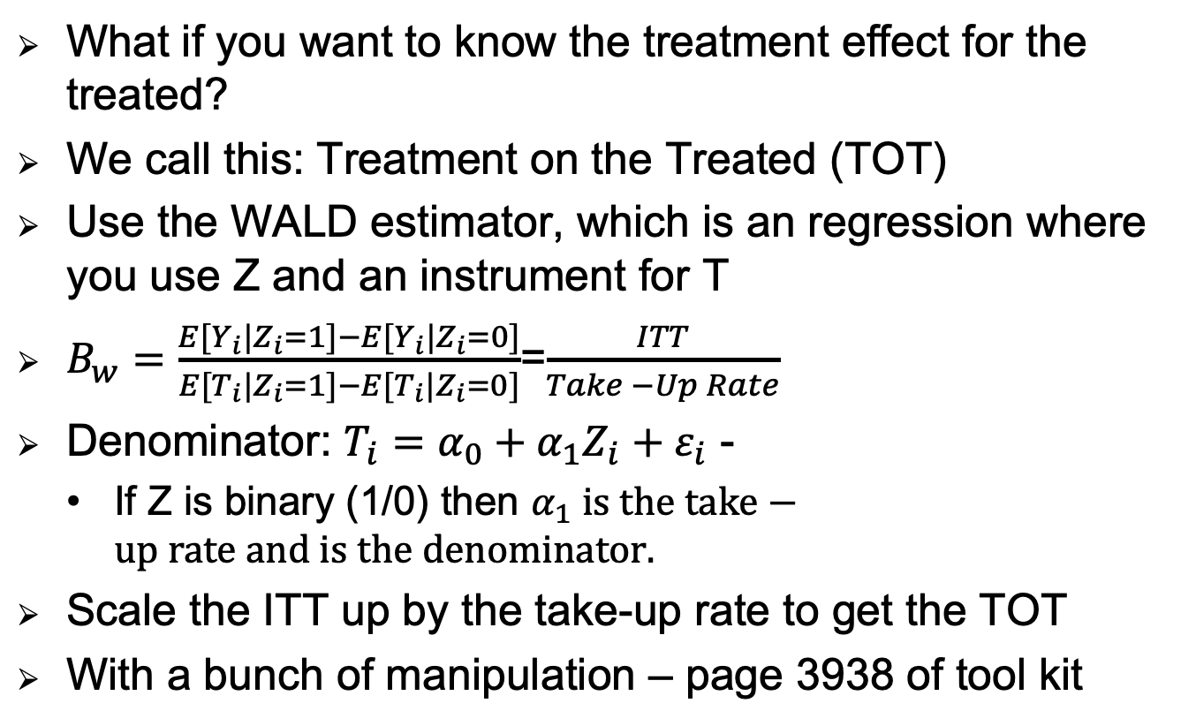
Regression Counterpart
Partial or Imperfect Compliance
What if you want to know the treatment effect for the treated?
We call this: Treatment on the Treated (TOT)
Use the WALD estimator, which is an regression where you use Z and an instrument for T
$B_{w}=\frac{E[Y_{i}|Z_{i}=1]−E[Y_{i}|Z_{i}=0]}{E[T_{i}|Z_{i}=1]−E[T_{i}|Z_{i}=0]}$=$\frac{ITT}{Take −Up Rate}$
Denominator: $T_{i}=α_{0}+α_{1}Z_{i}+ε_{i}$ -
  If Z is binary (1/0) then $α_{1} is the take−up rate and is the denominator.$
Scale the ITT up by the take-up rate to get the TOT
With a bunch of manipulation – page 3938 of tool kit

Slide 36
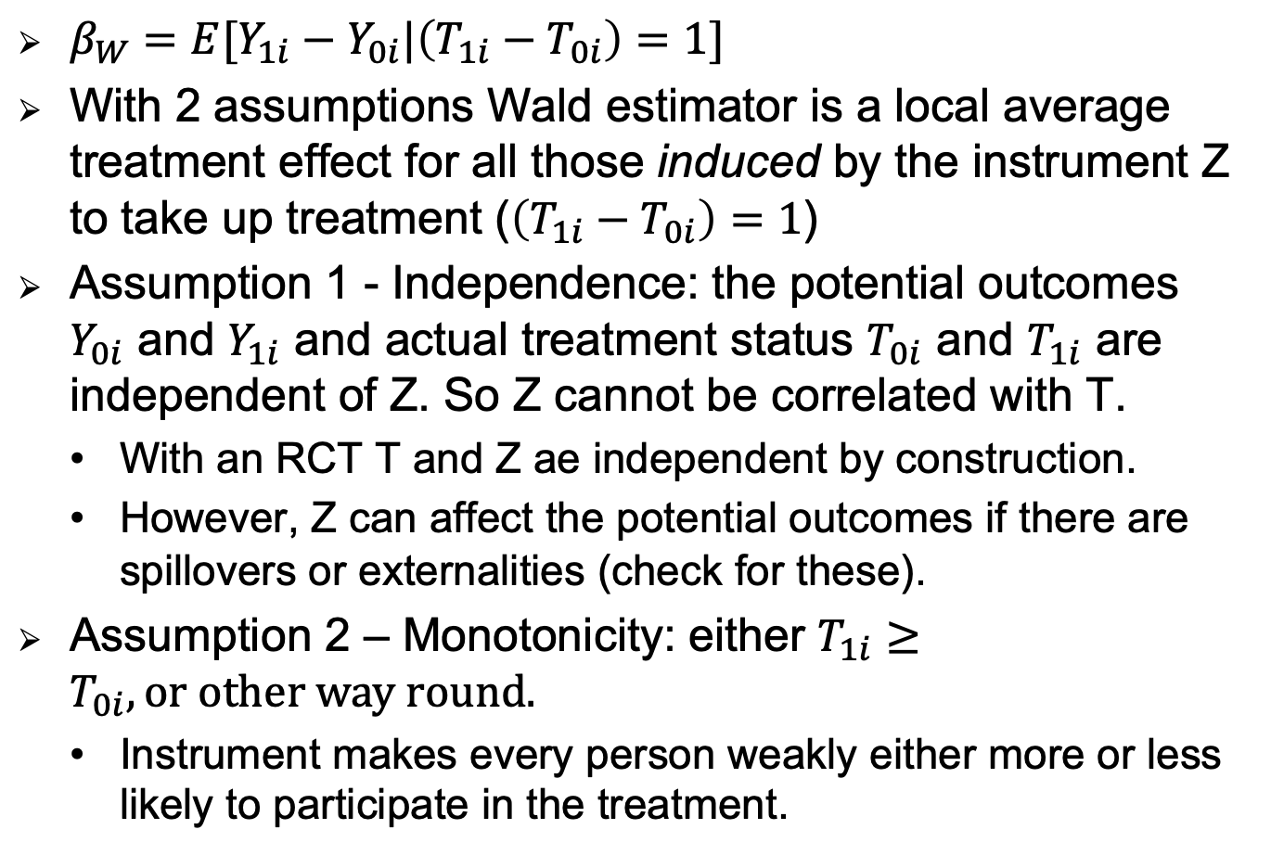
Regression Counterpart
Partial or Imperfect Compliance
$β_{W}=E[Y_{1i}−Y_{0i}|\left(T_{1i}−T_{0i}\right)=1]$
With 2 assumptions Wald estimator is a local average treatment effect for all those induced by the instrument Z to take up treatment ($\left(T_{1i}−T_{0i}\right)=1$)
Assumption 1 - Independence: the potential outcomes $Y_{0i}$ and $Y_{1i}$ and actual treatment status $T_{0i}$ and $T_{1i}$ are independent of Z. So Z cannot be correlated with T.
  With an RCT T and Z ae independent by construction.
  However, Z can affect the potential outcomes if there are spillovers or externalities (check for these).
Assumption 2 – Monotonicity: either $T_{1i}≥T_{0i}, or other way round.$
  Instrument makes every person weakly either more or less likely to participate in the treatment.

Slide 37
Potential Outcomes Framework
Reference
  Development Tool Kit (2, 6.2, 6.3)
  Angrist, Imbens, Ruben (1996)
  Imbens lectures: http://www.nber.org/WNE/lect_5_late_fig.pdf
  Mostly Harmless Econometrics

Slide 38
Writing/Discussing a Good RCT Paper
Describe the treatment well
Discuss compliance (take-up)
Think about level of randomization and if should worry about spillovers or externalities.
Show the randomization worked
Discuss compliance
See if the control could have been affected (e.g. look for spillover effects, discuss general equilibrium effects.
Discuss the external validity of the paper.

Slide 39
Benefits of Randomization
Fair way to allocated scarce resources
Improved causal inference -- internal validity:
  policy based on fads and weak evidence, helps bring evidence with limited bias issues.
Improve longevity of policies
Helps address publication bias
  Preference for non-zero results if not good internal validity
  Use data mining/work harder to find significant results
  Under-rejection of commonly held views
  RCTs
    Zeros more believable due to internal validity
    Analysis plan omit cherry-picking of controls, sub-groups etc.

Slide 40
Disadvantages
Retrospective analysis
  Can’t determine effect if didn’t randomize
Can’t always do it - monetary or trade policy
  Macro development issues
Narrowly defined questions
  Rodrik 2008 “Only truly hard evidence that randomized evaluations typically generate relates to questions that are so narrowly limited in scope and application that they are themselves uninteresting”
Notes:
Get quote from ar

Slide 41
Disadvantages: External Validity
Only provides an average program effects and need to know who it works for.
  Need to do heterogeneity anlaysis with baseline characteristics.
Don’t understand why it works.
  Need to think about and try to learn something about the mechanisms
Lack external validity
  Do answers carry over to other populations
  Often sample is not representative of the population
    Sociologist and demographers worry more about this

Slide 42
Disadvantages:
Policy Relevance: done by NGOs on a small population can’t tell how it will work if government implemented.
  Do them this way because easy and testing theory.
Geneal Equilibrium Effects
  Program effects in small study may not generalize when scale-up
  CCT’s – better human capital better jobs.
    But what if everyone had higher education – still get paid more? No wages would go down because supply increases
Multiple hypothesis testing: if test enough things something will be significant.
  Pre-analysis plans
  Families of outcomes
  Different tests for multiple hypotheses

Slide 43
Hawthorne and John Henry Effects
Being evaluated can change the results or behavior
  RCTs people know are being evaluated
  Hawthorne – changes in the treatment group
    Conscious of being observed or grateful, inducing behavior they would not otherwise.
    Exert more effort on cognitive tests – look smarter.
  John Henry – changes in the control group.
    Comparison group demoralized not treated or compete
  What to do?
    Collect longer-term data
    Program still going but evaluation not
    See if same effects if not constant surveys happening
  Have different social marketing arms

Slide 44
Internal Versus External Validity
Debate about what is more important
Dani Rodrik: divide between micro and macro development
  Macro – hard to experiment, but good external validity
  Micro -- can experiment, but external validity harder.
Randamista’s – focus on internal validity
  First get the right estimate, then think about external validity
  Criticism that only papers using RCT designs publishing in higher level journals

Slide 45
For Your Research
Think about this debate when chose/pitch papers
If can’t do an RCT
  Pick an outcome that is important and can’t do with RCT
    Mortality – unless mortality rates are high will never have enough sample with RCT
  Work on questions where randomization difficult
    But make sure still have some good identification.
  Look at effects on really big important policies where you want the real world estimate
    Point out why RCTs may not scale up etc.
  Highlight the external validity (and internal) of your results.
  Historical or longer-term results can’t get with RCT

Slide 46
Estimating the Counterfactual
Other methods to find a counterfactual include:
  Double Difference
  Regression discontinuity design
  These methods I do not cover:
  Natural experiments: program roll out
  Instrumental variables
  Propensity-score matching

Slide 47
Double Differences or
Differences-in-Differences (D-D)
Key Features
Can be applied when the program assignment rules are less clear
when randomization or regression discontinuity are not feasible
Requires at min: data prior to and after an intervention and policy change.
Assumption: parallel trends
  Need at least two periods of pre-intervention data to test this.
Can also run a D-D model with a randomized experiment
  Controls for any potential baseline differences in non-time varying variables

Slide 48
Double Differences
Set-Up:
Have a Treatment (T) and Comparison (C) group
Have data from at least 2 periods
  Period 0: Before the intervention (baseline)
  Period 1: After the intervention (follow-up)
  What is the counterfactual?

Slide 49
Double Differences
Set-Up:
Have a Treatment (T) and Comparison (C) group
Have data from at least 2 periods
  Period 0: Before the intervention (baseline)
  Period 1: After the intervention (follow-up)
  Counterfactual (in red): Change in outcomes for the comparison group.

Slide 50
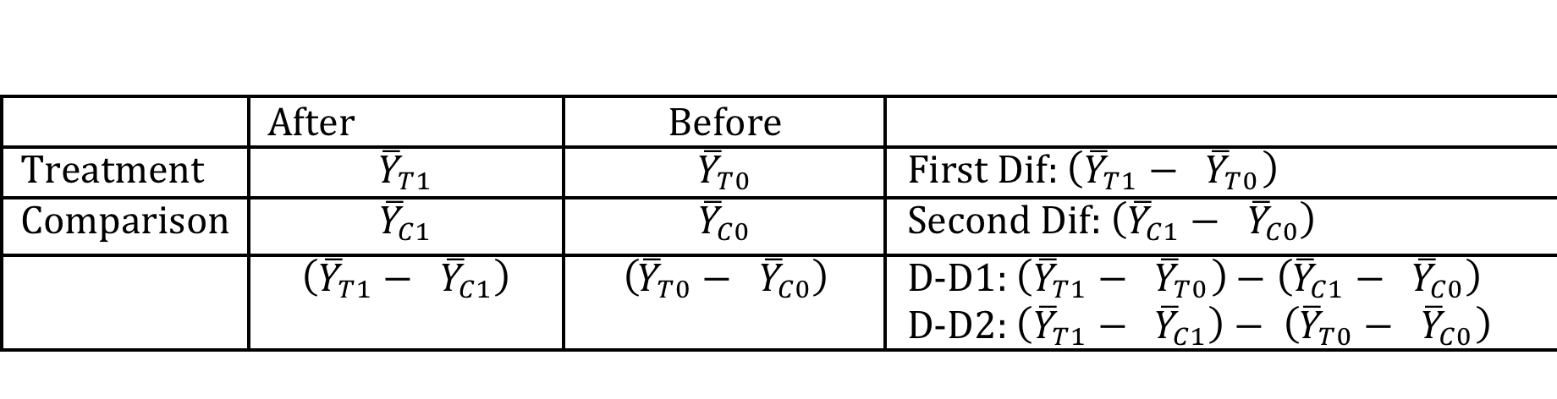
Counterfactual: two ways to think about counterfactual
DD1: Controls for changes over time
  Controls for time invariant differences in observable
DD2: Control for baseline differences between T and C
  Controls for time invariant observable an unobservable

Slide 51
Double Differences
  Assumption (parallel trends): The change in the outcomes variables in the absence of the program in the treatment area [for beneficiaries] is the same as the change in the program in the comparison areas [non-beneficiaries]
Cannot test assumption, can’t see what the change in outcomes for the treatment group would have been if they had not had the program
Check parallel trends before the program:
  Need two periods of data
  check if change in outcomes before the program between the treatment and comparison area are the same.
  If they are hopefully the assumption will hold.

Slide 52
Double Differences - Graph

Slide 53
Double Difference: Regression
Y is the outcome variable
T is 1 if in the treatment group, 0 in comparison
After is 1 if in the after period and 0 before
How do we estimate the ATE from the regression?

Slide 54
Double Difference: Regression

Slide 55
Double Difference: Regression
Y is the outcome variable
T is 1 if in the treatment group, 0 in comparison
After is 1 if in the after period and 0 before
How do we estimate the ATE from the regression?

Slide 56
Double Difference: Robustness
Check Assumption:
  Run the same regression but with two periods of pre-intervention/policy data. Run out outcomes variable but could also run on controls (Xs)
  What should gamma be?
    0
What else are you worried about?
  That there could be some other change or differences (observables or unobservables) between the two groups that could be driving the results

Slide 57
Double Difference: Robustness
What else could we do to provide confidence in the analysis?
  Add any control to account for any differences between the two areas over time
  Falsification Check (placebo test)
    Fake outcome: run analysis on a variable that you don’t think should be affected by program
      E.g. Examine IMR improved with water quality improvements
        Outcome: IMR for water-born disease,
        Falsification: IMR due to accidents is zero
    Fake Treatment Group
      Program that affected grade 6 students
      Falsification: effect on grade 7 students is zero. Want trends of the outcome to be the same for grade 6 and 7, and the only difference to be the intervention.
  Show that the baseline variable are similar, but stronger than assumption

Slide 58
D-D Time Location Fixed Effects & Program Roll-Out
Data
  Multiple time period and multiple units
    counties or villages are treatment and multiple observations over.
  May want to better control for the time of place effects by including fixed-effects for them both.
Where did After go?
Where did T go ?

Slide 59
D-D Time Location Fixed Effects & Program Roll-Out
Specification controls better for
  changes over time
  Differences between T and C
For roll out, or for regular D-D regression specification can look a bit different
Just have T_{it} which take on 1 the year that the unit becomes treated
  Doesn’t have to be the same year for each treatment

Slide 60
D-D Time Location Fixed Effects & Program Roll-Out
Robustness Tests:
Pre-program trends are not correlated with the entry into the program.
Entry_{it} take on the value 1 in the time period at which unit i entered the program
Entry is not associated with lagged performance. So those who doing worse/better enter first – this would cause selection bias
  L is 1 for the time period just before unit i entered program

Slide 61
Regression Discontinuity Design –RDD
Key Features
Eligibility Index/Variable: Who gets a program/intervention decided by some variable (i.e. income, poverty index)
  Examples: Progresa (poverty index),
  Columbia decides who get program based on poverty index SISBEN
  Test scores decide who gets scholarships in education
What is needed
  Eligibility index needs to be continuous
  Clearly defined cut off score (if not you need to do a Fuzzy RDD)

Slide 62
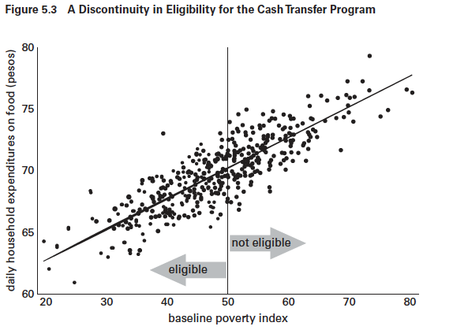
Regression Discontinuity Design –RDD Baseline Outcome
Source: Gertler et al. 2011 Impact Evaluation in Practice

Slide 63
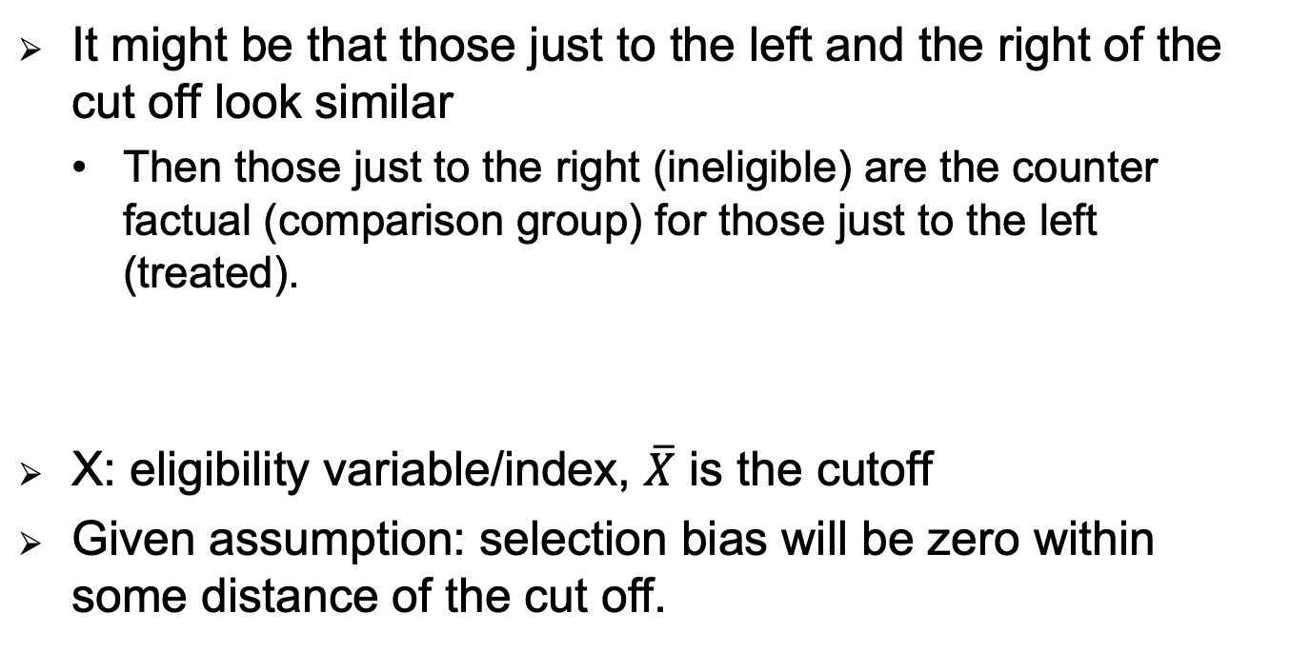
RDD: Assumption
It might be that those just to the left and the right of the cut off look similar
  Then those just to the right (ineligible) are the counter factual (comparison group) for those just to the left (treated).
X: eligibility variable/index, $\overline{X}$ is the cutoff
Given assumption: selection bias will be zero within some distance of the cut off.

Slide 64
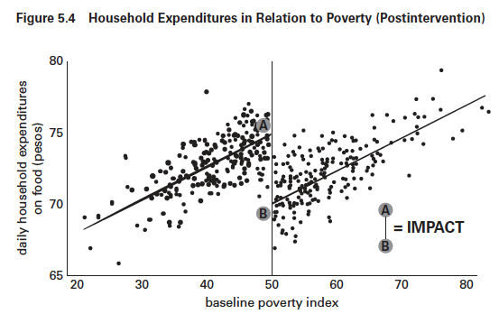
RDD: Estimate Impact Graphically
Source: Gertler et al. 2011 Impact Evaluation in Practice
Impact: size of discontinuity in regression lines at the cutoff

Slide 65
RDD: Functional Form Matters
Cubic function in red is a better fit of the data

Slide 66
RDD Form: Need Interaction Term

Slide 68
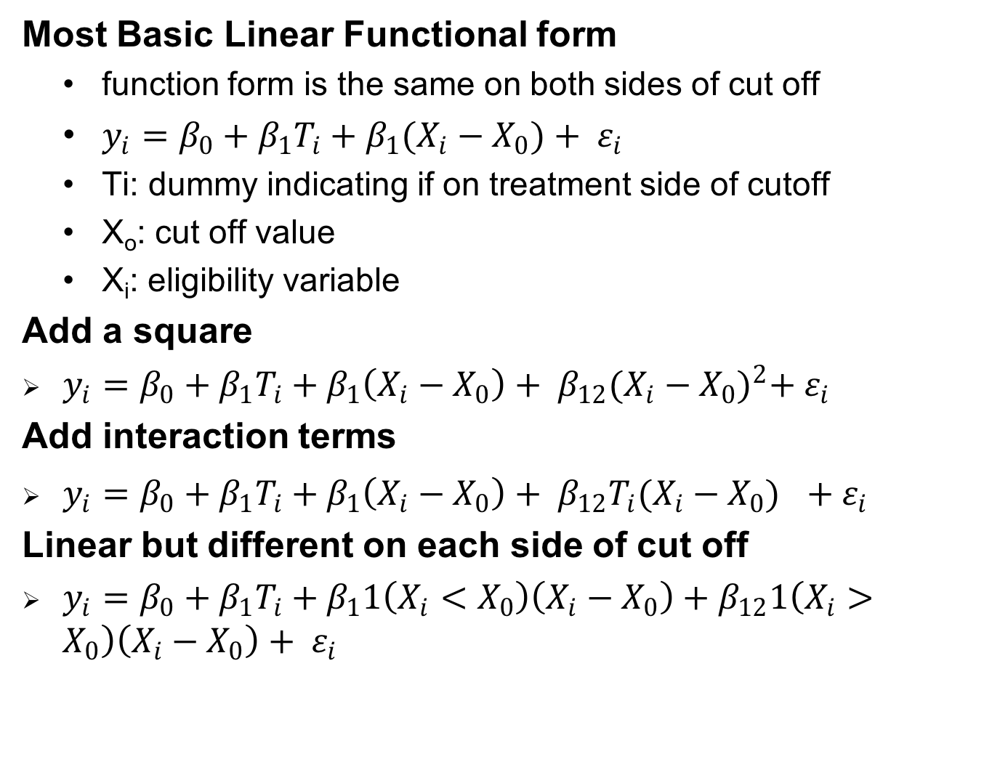
RDD: Estimate Impact Regression
Most Basic Linear Functional form
  function form is the same on both sides of cut off
  $y_{i}=β_{0}+β_{1}T_{i}+β_{1}(X_{i}−X_{0})+ ε_{i}$
  Ti: dummy indicating if on treatment side of cutoff
  X_{o}: cut off value
  X_{i}: eligibility variable
Add a square
$y_{i}=β_{0}+β_{1}T_{i}+β_{1}\left(X_{i}−X_{0}\right)+ β_{12}{(X_{i}−X_{0})}^{2}+ ε_{i}$
Add interaction terms
$y_{i}=β_{0}+β_{1}T_{i}+β_{1}\left(X_{i}−X_{0}\right)+ β_{12}T_{i}{(X_{i}−X_{0})}^{}+ ε_{i}$
Linear but different on each side of cut off
$y_{i}=β_{0}+β_{1}T_{i}+β_{1}1\left(X_{i}<X_{0}\right)\left(X_{i}−X_{0}\right)+β_{12}1\left(X_{i}>X_{0}\right)\left(X_{i}−X_{0}\right)+ ε_{i}$

Slide 69
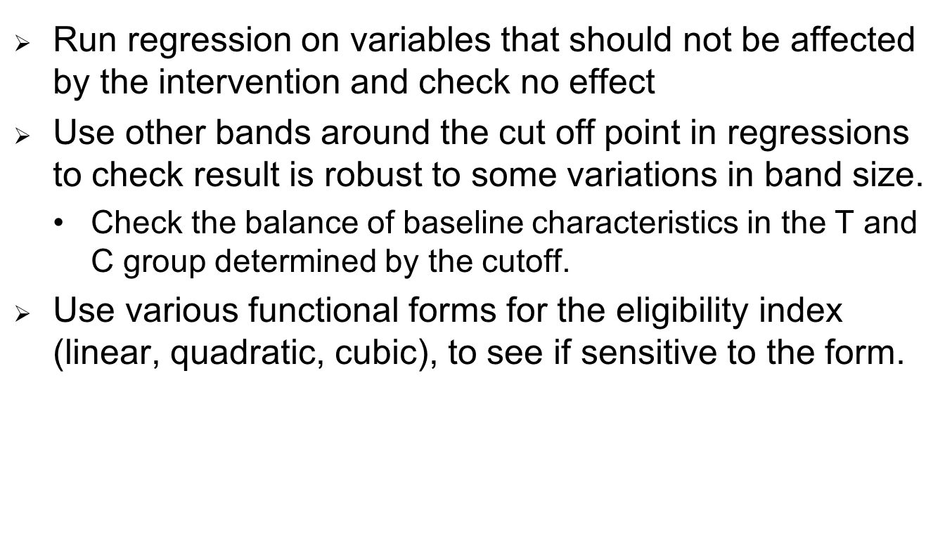
RDD: Robustness Checks
Run regression on variables that should not be affected by the intervention and check no effect
Use other bands around the cut off point in regressions to check result is robust to some variations in band size.
  Check the balance of baseline characteristics in the T and C group determined by the cutoff.
Use various functional forms for the eligibility index (linear, quadratic, cubic), to see if sensitive to the form.

Slide 70
Main Issues
Need to get the functional form right
  Effects are unbiased only if the function form of the relationship between the assignment variable and the outcome variable is modeled correctly
Anything that affects the size of the discontinuity other than the treatment is a treat
Gives LATE: so if are not interested in the impact of those around the cut off, this is not very helpful.
  May systematically over or under-estimate ATE
Statistical Power can be an issue because only estimate effect around the cut –off. So need large sample sizes.
  Trade off between statistical power and bias

