Slide 1
AI, ChatGPT, and LLMs: Guidance for IBS Faculty, Researchers, and Students
Don Mather, Ph.D. student | Sociology
Grant Matheny, Director of Information Technology | IBS
Notes:
Hello and thanks for taking time to join us today.
My name is Don Mather and I’m a graduate student in sociology and a statistics consultant for Computing and Research Services, here at the Institute of Behavioral Science
Our talk today is about the emerging technology that many are calling ‘AI’, ’artificial intelligence’ or ‘generative-AI” — and especially one in particular, ChatGPT – the software that has come to dominate the news in technology this year
The rise of chatbots like this has worried researchers and educators who fear they are ill-equipped to incorporate the technology into their work, or in their classes — and they’re worried about a stark rise in plagiarism and reduced learning, while others are concerned they simply lack the knowledge they need to keep current on these trends
As I’m sure many of you are aware, the recent roll-out last November of ChatGPT by OpenAI’s is all the talk - and virtually every day, we hear news and see articles about the incredible promise but also dire warnings about society’s plunge into “artificial intelligence”. It makes putting a talk like this together somewhat difficult, because it seems like learning about this technology is akin to taking a photo of a speeding train; what we know changes almost daily.
Nonetheless, this talk is meant to give you a high level survey of what this technology is and how others are using it; we’re going to explain some of the major promises and problems it presents, but we’re also going to focus on issues that are specific to educators and researchers, and offer up a few competing opinions about adopting the technology in our classrooms and in our research.
As you’ll see —there is little consensus among researchers and educators right now: for every professor who touts the tool’s wonders there’s another out there saying it will bring about doom. In my talk today, I’ll explain the leading opinions and their arguments; I encourage you to be critical of everything you hear, take the time to evaluate the sources we drew from, and recognize that when we give this talk again this Fall, it’s likely to contain different information than it does today
TIMED 2:15

Slide 2
Agenda
What are LLMs and ChatGPT?
How are others using LLMs like ChatGPT?
Current limitations
Issues people are talking about
Issues for educators and researchers to consider
Where to find out more
Notes:
In today’s talk, I will:
*) define large-language models like OpenAI’s ChatGPT and tell you what they can do; I’ll give you useful ways to think of the technology and explain the major terms you should know
*) I’ll discuss a few of the many and ways large-language models like ChatGPT are currently being used in a wide array of applications and industries,
*) I will provide a high-level list of some of the technological limitations we’ve identified in ChatGPT and explain why we think they are important for you to know,
*) I’ll provide some context under which this technology is emerging, and explain the major debates about AI and ChatGPT that are taking place across the media
*) then I’ll dial in a little more specifically to talk about issues surrounding generative-AI that we believe are important for educators and researchers to consider
*) at the end of this presentation, I’ll provide you with a link to our webpage that has a public Zotero library of the sources we used to compile our information, which we’ll continue to add to, along with links to other university websites and pages where you can find more information.
TIMED ELAPSED: 3:15

Slide 3
What are Large-Language Models?
Software that uses algorithms that analyze texts published on the internet to respond to user requests in human sounding ways
Predicts the next word in a sentence that best mimics humanlike conversation
Reinforcement and self-supervised learning
Rooted in technological advancements made in the 1950’s
AI: artificial = yes, intelligent = no
ChatGPT is just one LLM bot developed by the private firm OpenAI
Notes:
*) Let’s start by talking about what large-language models are and what they can do
*) Large language models are software, or applications that use algorithms to analyze a massive corpus of text scraped from the internet to respond to user requests in language that can sound surprisingly human. Users can ask the software questions in an instant-message like format, and it will answer the questions you ask it in full sentences, trying to mimic the rhythm of a conversation; users can also upload text and other data files to many of these models, including ChatGPT, and the software can re-write your text in a particular style, or analyze the data based on the questions you ask it
*) the software learns to predict the next word in a sentence by finding patterns through trial and error.
*) and its capabilities are constantly being refined using a tactic called reinforcement learning from human feedback, whereby real human trainers compare responses written by the software to those written by real humans and rank their quality, to help reinforce humanlike conversation styles;
*) It probably seems like to a lot of us that this technology came out of nowhere, but in fact it stems from a long history of research beginning in 1957 with the development of recursive neural network technology, and as such, there isn’t anything really new about ChatGPT that is especially new or revolutionary, aside from how it’s suddenly being deployed, and how we’re using it
Another term you’ve probably seen in the context of ChatGPT and similar software is artificial intelligence, or AI; which has become somewhat ubiquitous, but as you’ll see, there isn’t anything especially ‘intelligent’ about large-language models like ChatGPT – rather, they are, as you’ll see, entirely formulaic and probabilistic, and in many ways, the limits to their capabilities and what they do is very predictable.
*) and just to be clear, ChatGPT is a software developed by OpenAI organization. It is just one particular large-language model out there among many that are currently being referred to as “bots”.
TIMED ELAPSED: 6:30

Slide 4
How are others currently using ChatGPT?
Explosion of new AI and LLM models currently under development
Images (Midjourney)
Voices (Microsoft’s VALL-E)
Music (Amber)
Animation (Vyond)
Notes:
While today’s talk is focused mostly on the large-language model ChatGPT – which mostly accepts user-written text inputs and generates mostly text-based responses, it’s important to recognize that there are hundreds of other large-language models currently under development by a number of private firms that can do a lot more than generate text
In fact, some of the most cutting edge, advanced, and imaginative models can interpret the meanings of user inputs to generate a range of novel creations beyond text
here are a few things they can currently do:
#) Generate images from a user’s text input, such as this example from the LLMs called Midjourney
*) they can mimic people’s voices
compose songs with lyrics that rhyme, tell a story, or mimic specific styles
*) and some LLMs, such as Vyond, can even generate animated films
Now, to be clear, these are all software–based computer models written, under development, and trained by private-sector companies that offer access to the software to the public, just like OpenAI’s ChatGPT; they often require opening an account, and paying a monthly subscription
TIMED ELAPSED: 7:30

Slide 5
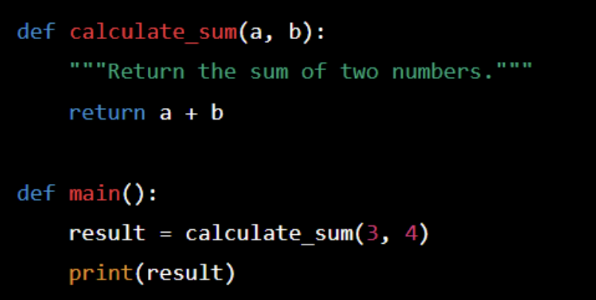
How are others currently using ChatGPT?
Song lyrics, TV scenes, and jokes
Computer code
Language translation
Essays and answers to tests
Notes:
Since Open AI’s public release of ChatGPT, there has been widespread media coverage of the diverse ways users have engaged with the software:
*) The New York Times has been publishing articles describing creative and sometimes surprising ways user have figure out how to use it. One article that caught my eye featured someone who asked the software to write song lyrics about how AI is taking people’s jobs—but in the style of the rapper Eminem—while another user asked ChatGPT to write new scenes that would fit into the NBC sitcom “The Office,” tailored to ongoing storylines such as a prank war between the characters Jim Halpert and Dwight Schrute.
*) ChatGPT can write and translate computer programming languages such as Python or R; it can generate code code and lines of syntax from user requests like “write a program in Python that generates a radar plot” - it can also translate between languages, such as between (python and R) and (R and Stata) - it can even debug code, if you ask it the right way
*) but ChatGPT is also an extremely sophisticated language translator, because it relies less on the actual words and more on what you mean when you ask it to translate something you’ve entered
*) Yet perhaps stories of ChatGPT’s ability to formulate well-structured arguments, write clear and well-organized, evidence-based prose in the form of academic essays that has garnered the most attention. There is evidence that ChatGPT can formulate responses that pass a range of standardized tests, such as the Unified Bar exam.
I even read a report in last week’s New York Times that Google is currently developing a ChatGPT like large-language model that will dispense life advice
TIMED ELAPSED 8:30

Slide 6
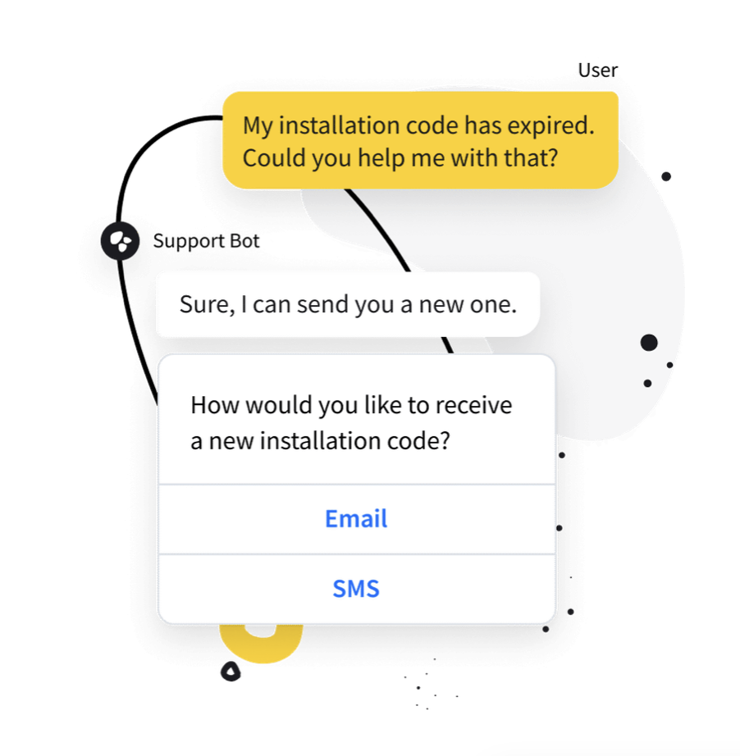
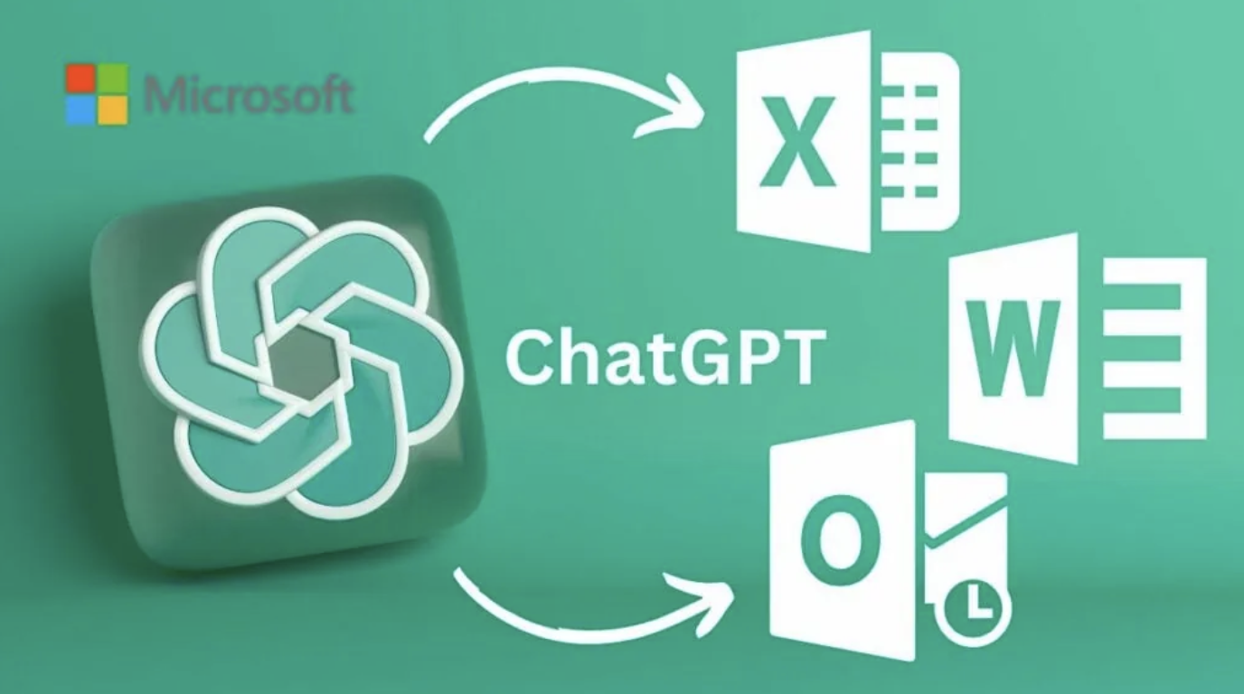
How are others currently using ChatGPT?
Science, medicine, law
Employment
Academic writing and exams
Copy editor
Search engines
“Helper bots’ in Word and Excel
Customer service
Notes:
In fact, there are a broad range of emerging technologies in the fields of science, medicine, and law that are using and incorporating large-language model technology and ChatGPT
*) One recent article in the New York Times described how doctors are using ChatGPT to improve how they communicate with patients via email, while another featured how law clerks are using ChatGPT to summarize court cases
Within many academic and professional disciplines, individuals are using ChatGPT to:
*) formulate and write resumes / cover letters / professional emails, as well as for summarizing and analyzing those written by others, including job applicants
*) many users are engaging with the software to draft manuscripts/complete comprehensive exams/and write portions of their theses and dissertations
*) still others are using them as sophisticated copy editors (similar to Grammarly)
Large-language models like ChatGPT are quickly being integrated into technologies we all use, everyday, in fact, you’re probably already seeing it in menu bars in Microsoft products, like Word and Excel. When we were putting this PowerPoint together, the Microsoft AI bot integrated into Powerpoint offered real-time suggestions on the wording and format of the slides you’re seeing here right now
And if you didn’t know this already, many of the automated help and customer service chats you may be accustomed to have been been using non-human generative-AI technology for a few years now
TIMED ELAPSED 9:45

Slide 7
What are some of ChatGPT’s current limitations?
Cannot access the internet directly
Limited to information published to the internet prior to 2021
Cannot critically evaluate sources of information
Cannot discern truth or facts
Notes:
But despite their vast capabilities, there are hard and fast limits to the things these bots can do, and most large-language models like ChatGPT have constraints on the kinds of information they have access to, as well as various kinds of built-in ‘guardrails’ designed to prevent users from abusing or misusing the technology. In many cases, these restrictions, or constraints also better help us understand what we can and can’t do with them:
*) the first thing to understand is that despite the fact that generative-AI models like ChatGPT are trained on vast amounts of text published on the internet, it does not have direct access to the internet and as such, it cannot go out on the internet and ‘browse’ websites for information like Google search can; it is not a great way to search for new information you know nothing about
#) also, ChatGPT is trained on data published on the internet prior to 2021, so it may not always be working with current information:
*) ChaptGPT cannot critically evaluate sources of information, data or other web resources. It doesn’t have the ability to select from reputable sources only, and generally speaking, it can’t differentiate the truthfulness or factuality between a piece of data it selects from an academic journal article it was given access to, or a Wikipedia page - and therein lies one of the biggest problems with society’s rush to adopt it
TIMED ELAPSED: 11:00

Slide 8
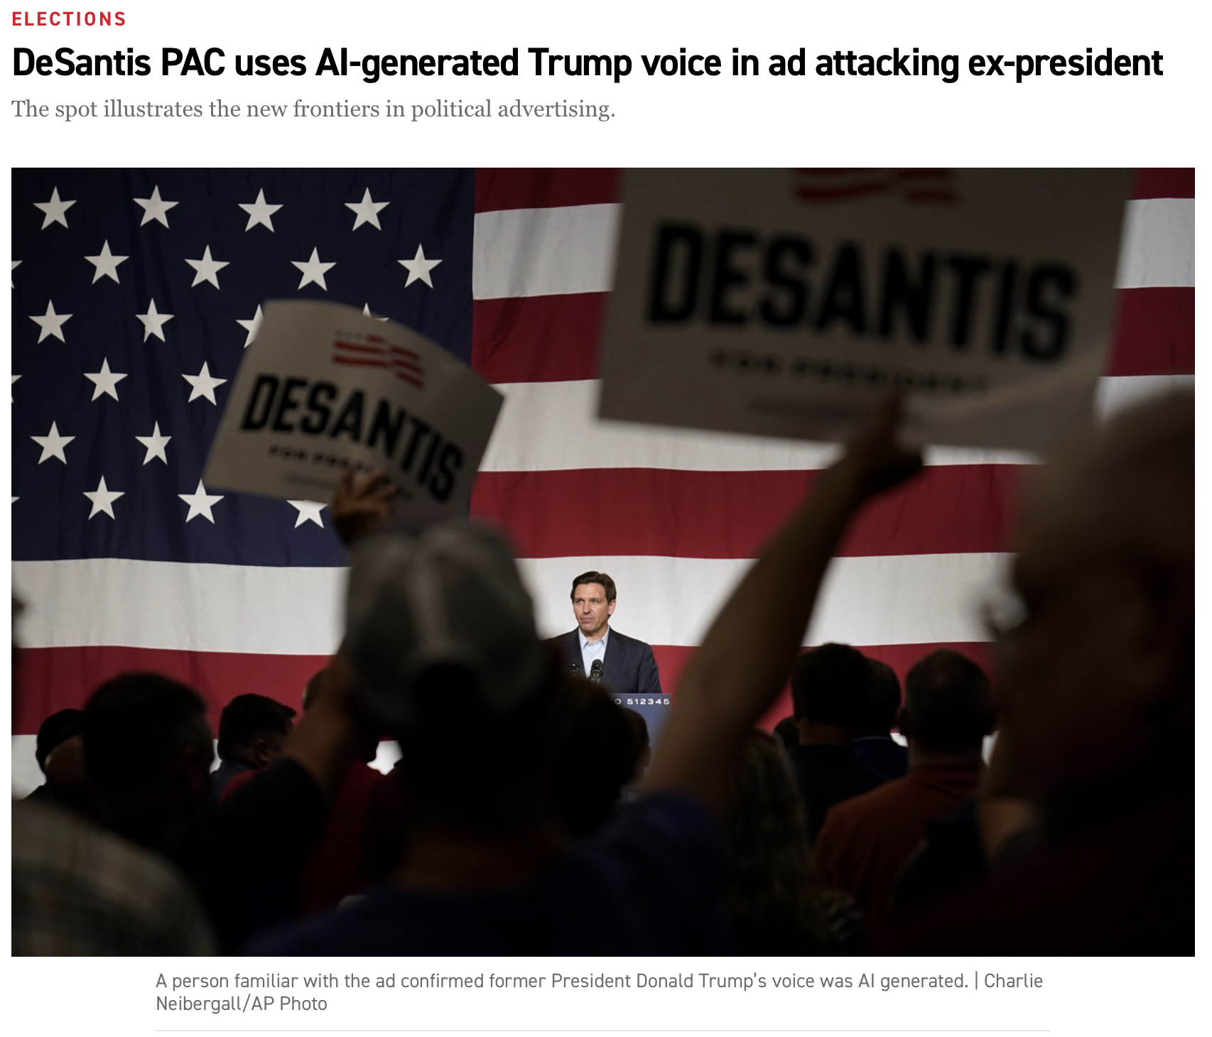
ChatGPT in the News
Broad misconceptions of the technology and its capabilities
Displacements, disruptions
Disinformation
Deepfakes and spam
Propaganda
Harmful content, biases, and stereotypes
Factuality and truthfulness
Notes:
given the explosion of media coverage and rapid roll-out of large-language models by numerous companies all at once, it’s probably no shock to you that one of the major problems we’re facing in society are *) broad, general misconceptions surrounding the technology and precisely what it can do
As I mentioned, these bots are not ‘intelligent’; they don’t have personalities or values. But because the responses these models generate are drawn from diverse texts written by diverse people with diverse aims, personal values and other biases will likely still come through in their answers and the results they return
*) Despite these shortcomings, we hear numerous reports in the media that ChatGPT and similar technologies are job killers, where positions like customer service representatives, marketing professionals, and doctors are quickly being replaced by bots, though I think some sobriety has returned to those debates recently
We’ll see if any of that comes to fruition. *) *) Yet what seems to worry experts most is the ability for individuals to use large-language models like these for disinformation, creating and disseminating deep fakes, generating spam and executing ultra-personalized fishing campaigns and custom click farms
#) images, like this photo of Pope Francis wearing a $25,000 Balenciaga puffer, produced by a 25-year old construction worker in New Mexico with large-language model software Midjourney last Spring, went viral and caused controversy
#) we also recently saw an example of how generative-AI can be used for propaganda, when the Ron Desantis Campaign for President produced and released a video clip containing an AI-version of Donald Trump’s voice
In fact, some of the most important and pressing research being done with large-language models is how to prevent *) harmful content that mimics, amplifies, or otherwise perpetuates social biases and negative stereotypes that are ubiquitous and endemic to the internet-at large today
*) and of course, there have been numerous humorous and scary examples of ChatGPT making up answers, seemingly from thin air, in what are being called ‘hallucinations’ – an example of this might be asking ChatGPT “When did Leonardo DaVinci paint the Mona Lisa?” and it replying “Leonardo DaVinci painted the Mona Lisa in 1815” – it sounds authoritative, but is entirely wrong, and we have no way of knowing where, exactly it got that information. In another recent, well-publicized case, a trial lawyer in New York was reprimanded by the courts for submitting a summary of cases he wrote using ChatGPT, and two of the cases and their particulars were entirely made-up by the bot.
TIMED ELAPSED 12:30

Slide 9
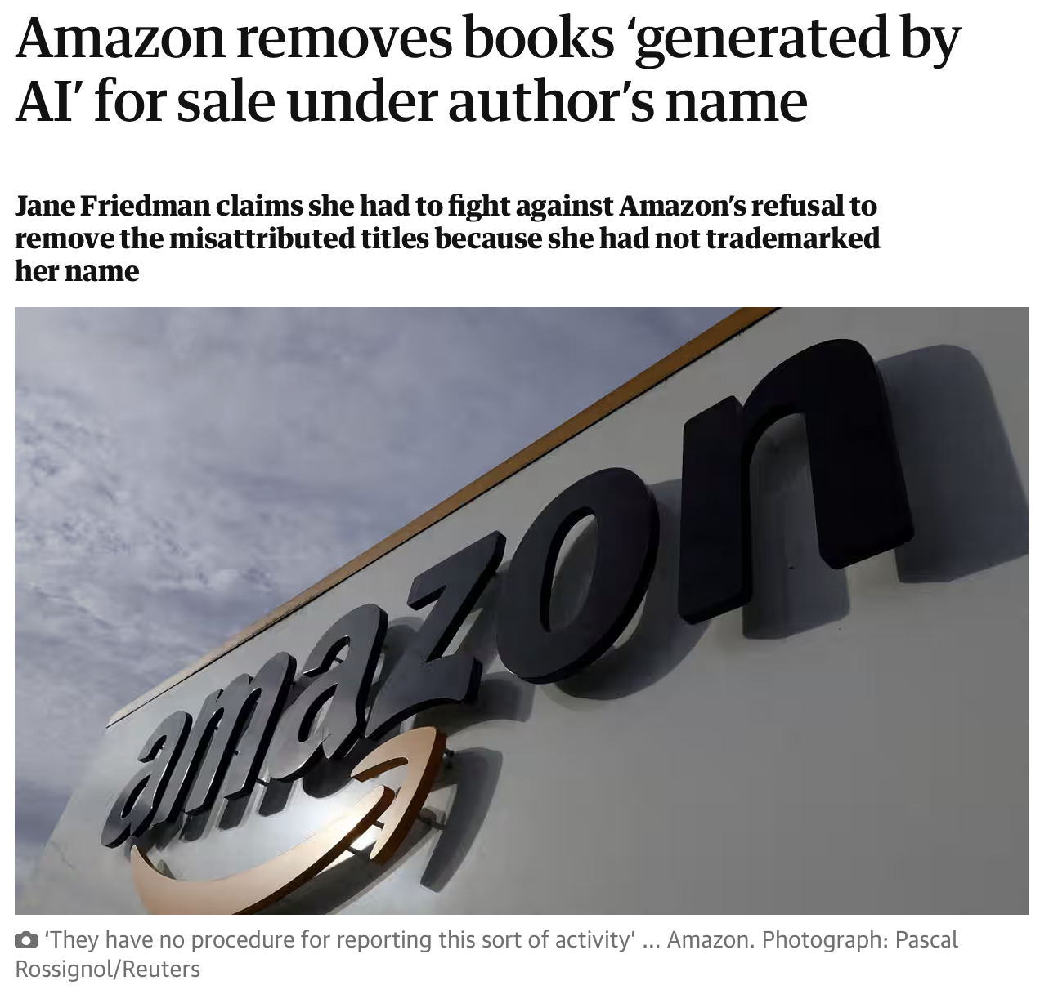
ChatGPT in the News
Ownership, copyrights
Defamation
Misuse
Privacy and security
See CU’s Office of Information Technology 4/19/23 announcement
https://oit.colorado.edu/news/chatgpt-data-security-concerns
Notes:
*) one of the more contentious issues emerging with LLMs and ChatGPT is over who owns AI-generated content. Recently, a federal judge in Washington, D.C. ruled that AI-generated content cannot be copyright protected, and it remains to be seen what implications this has for how people ultimately use generative-AI and how we define intellectual property
AI-generated books are currently flooding Amazon and other online bookstores, sometimes borrowing real authors' names.
Last week, a publishing expert by the name of Jane Friedman made headlines with a blog post about her discovery of fake books likely generated by AI that claimed to be written by her and used her name: she had to petition Amazon to remove said books from their online store, and she didn’t have an easy time of it
You might think it would be easy for readers to discern the real thing, but today, even the reviews for online marketplaces are being infiltrated by generative-AI bots who write reviews aimed at skewing the rankings
Meanwhile, the use of books in the training of AI firms' large language models is a hotly contested topic, as authors seek to prevent unauthorized, uncompensated use of their work, as reflected in a recent lawsuit by the comedian Sarah Silverman against OpenAI pertaining to the unauthorized use of her work in their model training.
*) but perhaps one of the most important issues for ALL users to consider right now is privacy and security. It’s important to understand what role users play in the training for these models, what kinds of information we choose to share with them. It raises a number of questions to consider when we upload personally-identifying or personally-generated content to any app on the internet. Although our current understanding is that none of the LLMs are incorporating user data into the responses they generate, and that all of the reinforced ‘learning’ the models have undergone has been done by humans, most companies have said they plan to incorporate user responses to train models in the future
*) on this point, we would encourage you to check out the advisory and set of practical advice issued by CU’s office of information technology earlier this Spring at oit.Colorado.edu
TIMED ELAPSED: 14:00

Slide 10
Issues for Educators to Consider
Student cheating and plagiarism
Diane Sieber, Herbst Program for Engineering, Ethics & Society, CU Boulder
Notes:
Let’s turn our attention to specific considerations for educators and researchers
As many of you are already aware, there are a number of important debates underway surrounding the use of ChatGPT by students and the impact of such technologies in the classroom.
When OpenAI released ChatGPT late last Fall, educators knew immediately they were facing a generational shift in the classroom. Many professors worried that students would use it for homework and tests. Others compared the technology to the calculator, arguing that teachers would now have to provide assignments that could be completed with AI.
One of the more contentious and timely issues is the fear that ChatGPT allows for rampant cheating, plagiarism, and the misuse by students of AI-generated content.
Institutions like Sciences Po, a university in Paris, and RV University in Bangalore, India, banned ChatGPT, concerned it would undermine learning and encourage cheating. meanwhile, professors at colleges such as the Wharton School of Business at the University of Pennsylvania and Ithaca College in New York allowed it, arguing that students should be proficient in it.
Now, educators are rethinking how they’ll teach courses this fall. Educators say they want to embrace the technology’s potential to teach and learn in new ways, but when it comes to assessing students, they see a need to “ChatGPT-proof” test questions and assignments. For some instructors that means a return to paper exams. Some professors will be requiring students to show editing history and drafts to prove their thought process. Other instructors are less concerned. They say that some students have always found ways to cheat, and this is just the latest option.
In any case, an explosion of AI-generated chatbots including ChatGPT has raised new questions for academics dedicated to making sure that students not only can get the right answer, but also understand how to do the work.
Here, I’d like to offer up two competing ideas for how educators are thinking about large-language models like ChatGPT in the classroom. In the first, I’ll play a clip of a video of Diane Siebler of the Herbst Program for Engineering, Ethics & Society here at CU Boulder from a presentation she gave about ChatGPT on campus back in April, talking about the advantages of embracing the technology for students:
#### (original unclipped link: https://www.colorado.edu/cs/2023/03/21/chatgpt-fear-hype-or-hope-public-session-generative-ai)
TIMED ELAPSED: 15:30

Slide 11
Issues for Educators to Consider
From https://youtu.be/6nkKFmFOoOE?t=1440
Notes:
TIME ELAPSED: 17:30

Slide 12
Issues for Educators to Consider
“While the tool may be able to provide quick and easy answers to questions, it does not build critical-thinking and problem-solving skills, which are essential for academic and lifelong success”
- Jenna Lyle, a spokesperson for the New York City Department of Education, in a statement to The Washington Post.
Can AI-generated content be detected?
Notes:
Now let’s compare Diane’s vision with a statement by Jenna Lyle, spokesperson for the New York City Department of Education, that she gave recently to The Washington Post:
“While the tool may be able to provide quick and easy answers to questions, it does not build critical-thinking and problem-solving skills, which are essential for academic and lifelong success”
The fact that such divergent opinions are being held concurrently within academia suggests we have a long way to go before we can settle on norms
For some educators, detecting LLM-generated work in student’s assignments is the primary concern. Turnitin – one of the largest and well-known software developers of plagiarism scanning technologies admitted in a June interview that their software really can only detect common AI-like text some of the time, and the ability to do so reliability may not ever be possible
In fact we’re not aware of any current technology that can reliably detect AI-generated content, and this will likely lead to predictable outcomes:
— Will students get falsely accused of using artificial intelligence platforms to cheat? Absolutely. In one case last semester, a Texas A&M professor wrongly accused an entire class of using ChatGPT on final assignments. Most of the class was subsequently exonerated.
— Can educators be certain if a student has used an AI-powered chatbot dishonestly? Right now, from everything we can tell, It’s nearly impossible unless a student confesses.
TIME ELAPSED: 18:30

Slide 13
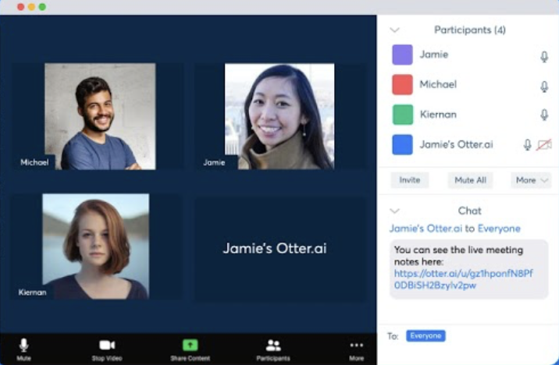
Issues for Educators to Consider
Enhancing user’s education
Improving student writing
Tutoring and assisting
Alternate ways to engage
Notes:
Despite these problems, educators who have embraced the use of ChatGPT, like Diane Siebler, claim the technology has the potential to *) enhance one’s education by *) improving student writing by raising the writing capabilities of those with the lowest skills, while allowing better-skills students the ability to focus on higher order writing skills, like developing clear arguments, organizing and presenting compelling evidence, and mastering different voices
*) ChatGPT and similar technologies can also provide students with a highly-sophisticated tool for quickly absorbing, learning, and mastering concepts, such as how to build an Excel spreadsheet to generate a particular type of graph, or how to write an abstract for a journal article submission.
Those of you who teach or hold meetings remotely over Zoom and Teams can anticipate seeing generative-AI bots like Otter.ai appearing in their Zoom meetings; this is a company that provides an interface that joins online meetings and summarizes the meeting for its user, including who said what, lists and follow ups. This feature is already available in Zoom, which means you didn’t really even need to come to our talk today. We expect you’ll see many different kinds of automated ‘attendant’ types of AI applications, especially those geared towards assisting students with certain types of accomodations, and you won’t always know whether students are using them or not
*) In any case, it is our position that if creatively and thoughtfully deployed, generative-AI like ChatGPT can offer possibilities for new and novel ways to #) engage with students. One of my peers, for example, asks her students to answer a question using ChatGPT, then offer up suggestions on how to improve the bots’ writing output.
TIME ELAPSED: 19:30

Slide 14
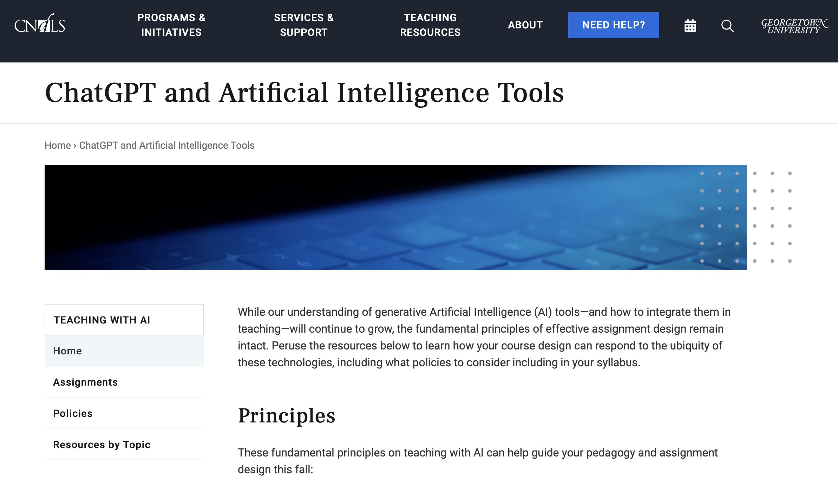
Issues for Educators to Consider
Assessing and grading
Writing course syllabi and designing assignments
Citing and referencing conventions
Access and Equity
Notes:
is there anyone here who has incorporated ChatGPT in their classroom? (can you briefly tell us about it?)
*) Educators who have embraced the technology have found numerous ways using ChatGPT can
*) save them time and effort, leaving them more time for student engagement
#) many universities have released guidance for educators, including how to cite and reference AI-generated content, as well as best practices for incorporating LLM in research. This is a screen shot of the resource page for faculty published by Georgetown University.
College administrators have been encouraging instructors to make the ground rules clear.
Many institutions are leaving the decision to use bots in the classroom to instructors
At Michigan State University, for example, faculty are being given “a small library of statements” to choose from and modify as they see fit on syllabi
And at Temple University, administrators offer faculty sample syllabi incorporating AI-technologies into their course designs, assignments and assessments.
There already exist academic and professional conventions for citing and referencing AI-generated content in APA, ASA and MLA formats, which you can find at Purdue University’s writing lab website
***Perhaps one of the biggest issues educators face as AI-tools become more and more commonplace are issues surrounding student access to the technology and equity in terms of the benefits students derive from it. On the one hand, much like access to the internet, some of our students won’t have access to ChatGPT – some won’t have smartphones with the ChatGPT app, still others won’t be able to afford the monthly subscriptions many of these companies charge for access to their premium products. It’s also entirely logical to me to think that what students ultimately get out of the technology might be different whether or not they have a parent in the house who can impart knowledge on how to use them
One of our obligations as educators is to anticipate these effects and find ways to mitigate them
TIME ELAPSED 22:30

Slide 15
Issues for Researchers to Consider
Questions about methodology, validity, and reliability
Incorporating AI-generated content
Copyright infringement and identifying copyright-protected content
Ill-equipped for rigorous searching and numerical analyses
Bias
Notes:
Researchers who wish to use LLMs in their current state for research face a number of obstacles related to validity and reliability because the process for using ChatGPT to analyze data or return results is often difficult to define and unlikely to be repeatable – someone following your exact procedure is likely to obtain a different response, even if that difference is small. And the nature of those responses given by bots like ChatGPT are ever-changing as they continue to train on new material. One interesting question that has emerged is what happens when these models begin training on material they themselves have generated and what exactly then constitutes novel knowledge…
Similar to some of the same issues related to detecting AI-generated content that those in teaching currently face, the inability to detect copyright-protected text within the model’s responses potentially puts researchers at risk of copyright infringement, and in any case, it makes it difficult for researchers to in all cases know where AI-generated material pulls from.
Earlier, I highlighted some of the limitations ChatGPT has in accessing current data on the internet, and problems users have reported with factuality. Current research aimed at testing ChatGPT’s data analysis capabilities continues to demonstrate that the software has weaknesses; for example by losing track of what it’s doing when given complicated or long instructions, and hallucinating results. It’s our opinion that these and other issues make LLMs like ChatGPT ill-equipped for rigorous literature reviews and data analysis, but this situation will certainly change, and fast. I don’t think it is controversial to say that anyone who is a serious researcher needs to consider the impact and utility of generative-AI technologies on the work they do.
But perhaps what concerns me most about using ChatGPT for research are the potential biases I see, and in the software’s potential ability to foreclose knowledge about some communities and not others, because some communities’ experiences are not and never were captured in texts published to the internet; The proliferation of using large—language models also reifies specific epistemologies, privileging and mimicking Western-modes of thought and Western-ways of knowing
TIME ELAPSED: 24:00

Slide 16
Issues for Researchers to Consider
Consuming large amounts of information
Highly sophisticated text tool
Notes:
Despite these limitations and others, LLMS like ChatGPT are innovative new tools for researchers that have learned to hone their capabilities
One of the most powerful things LLMs like ChatGPT can do is consume and summarize vast amounts of information, like journal articles and books, and asking it to summarize that content is one way researchers can use ChatGPT in their work.
the current versions of LLMs like ChatGPT are also highly capable text tools…similar to but far more sophisticated than Grammarly. They can help you generate new ideas for titles, suggest better ways of phrasing and organizing discourse, composing arguments, and presenting evidence. They respond to commands like “Make this 30% shorter” and “Make this more concise” - and as you also saw in our earlier demonstrations, they can mimic tones and voices and particular writing styles. They can even make something you provide it sound more like something you would write.
Our position is that potential of these products to revolutionize the manner in which we conduct research is inevitable, and those researchers who invest in learning about them now will almost certainly benefit from the curve
TIME ELAPSED: 24:30

Slide 17
Where to find more information
https://ibs.colorado.edu/large-language-models
Notes:
As a supplement to this talk, here is a link to a page on our website with more information. We assembled all of the sources we used to compile this talk and a lot more in an online Zotero library. It contains articles, links to websites and various media, along with university resources on LLMs and ChatGPT in particular.
In the coming weeks and months, we’ll continue to add to this library and provide updates on LLMs, ChatGPT and their impact on us here at the Institute of Behavioral Science. In the meantime, I encourage you to explore it, give us feedback, and copy us on any articles you think we should add. Looking foreward, we’re keen on providing our community with information and updates on the topics they care most about, so please let us know what you think of our talk today, and how we can improve it.
Thanks!
TIME ELAPSED: 25:30

Slide 18
Closing Remarks
Predictions for the future
Inevitability of integration and expanded uses
Continued issues with data integrity, transparency, authenticism, and ownership
Do LLMs create new knowledge?
Notes:
As I mentioned earlier, it’s been an effort to stay up to date with the flurry of media coverage over LLMs and ChatGPT because every development seems to have widespread implications that take time to understand. In fact just this weekend we read news articles that ChatGPT is suddenly experiencing it’s first decline in new users, which already has some speculating about the technology’s bust.
But from everything we can tell, this too is probably premature. And even if interest in ChatGPT fades somewhat, it’s unlikely to stem the tide of companies who are currently integrating generative-AI technologies into their products, or the rush of students who are increasingly using them in the classroom.
We expect that for the foreseeable future, we’ll continue to struggle with issues of data integrity, transparency, authenticity, and ownership of AI-generated content
And finally, I’d like to leave you with a few philosophical question on epistemology and art: do LLMs create new knowledge? And what constitutes creativity in the sense of novel work? And, is knowledge borne out of the answers generative-AI provides, or in the questions its users ask?
TIME ELAPSED: 27:15

Slide 19
Thanks
Notes:
Thanks

